Slide 1



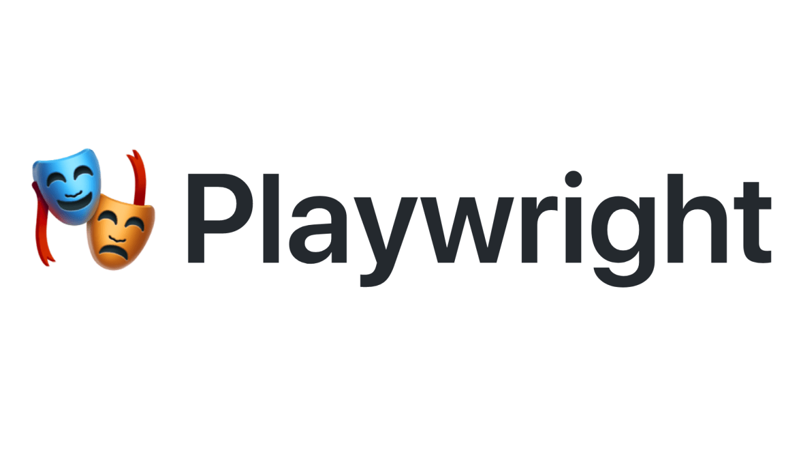
Learning PlayWright (Java)
Pramod Dutta
SDET Manager
E2E Web Testing with Playwright(Java) - Part 1
Become SDET- sdet.club

Slide 2
Agenda
Introduction to Cypress
Why Cypress & Cypress Popularity
Cypress Components & Cypress Architecture
Perform LIVE Project #1
QnA
UnLock Cypress Advance Course.

Slide 3
Cypress Introduction.

Slide 4

Why Cypress?
1. Fast execution, Dom Snapshot, Easy Debugging.
2. Automatic Waits for the commands.
3. Problem with the async calls.
4. Mocking the Server response.
5. DOM Snapshot.
6. Force Click and Smart assertions.
7. You can avoid flaky test, create robots and reliable test.
8. Video, Screenshot and Inbuilt Reporting.
9. Cross Platform Testing. ( CBT)

